Slide 1
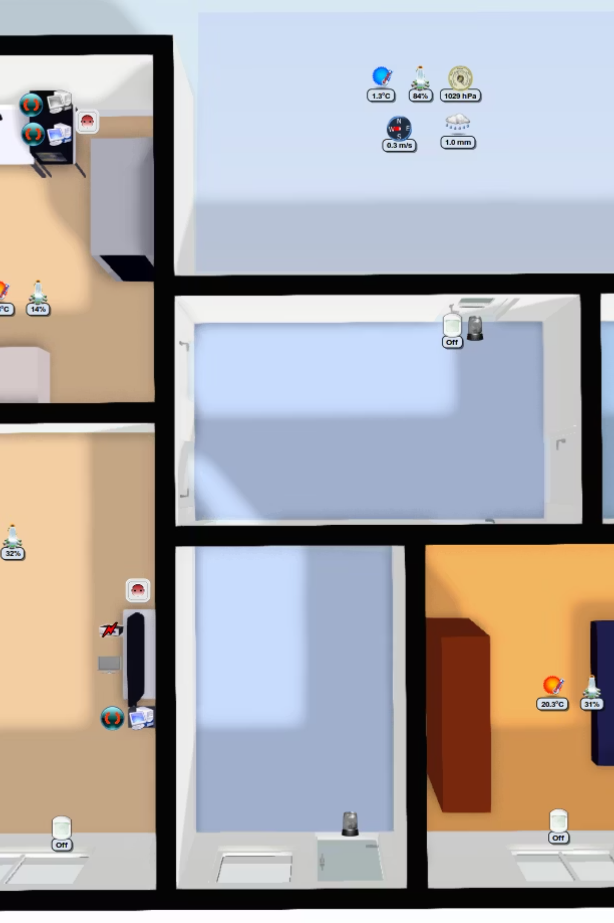
Smart Energy-Saving Room System Using PIR Sensor
Team Members: Pranesh Y, Monish S, Mayakannan K
Guided By: Prof. Dr. G. Jagajothi

Slide 2

Introduction: Problem Identification
Energy Waste in Empty Rooms
Electricity is continuously wasted when lights and fans remain ON in unoccupied rooms, leading to significant power loss.
Manual Control Inefficiency
Traditional manual switching relies on human memory and attention, often resulting in unnecessary power consumption throughout the day.
Need for Automation
There is a critical need for an intelligent, automatic system that can detect room occupancy and control appliances without human intervention.

Slide 3

Project Objective
Human Presence Detection
Automatic Appliance Control
Accurately detect human presence using PIR sensor technology with reliable motion sensing capabilities.
Automatically control lights and fans based on occupancy detection without manual intervention.
Reduce Power Consumption
Low-Cost Solution
Significantly reduce electricity consumption by eliminating unnecessary appliance operation in empty rooms.
Develop an affordable automation system that can be easily implemented in various settings.

Slide 4
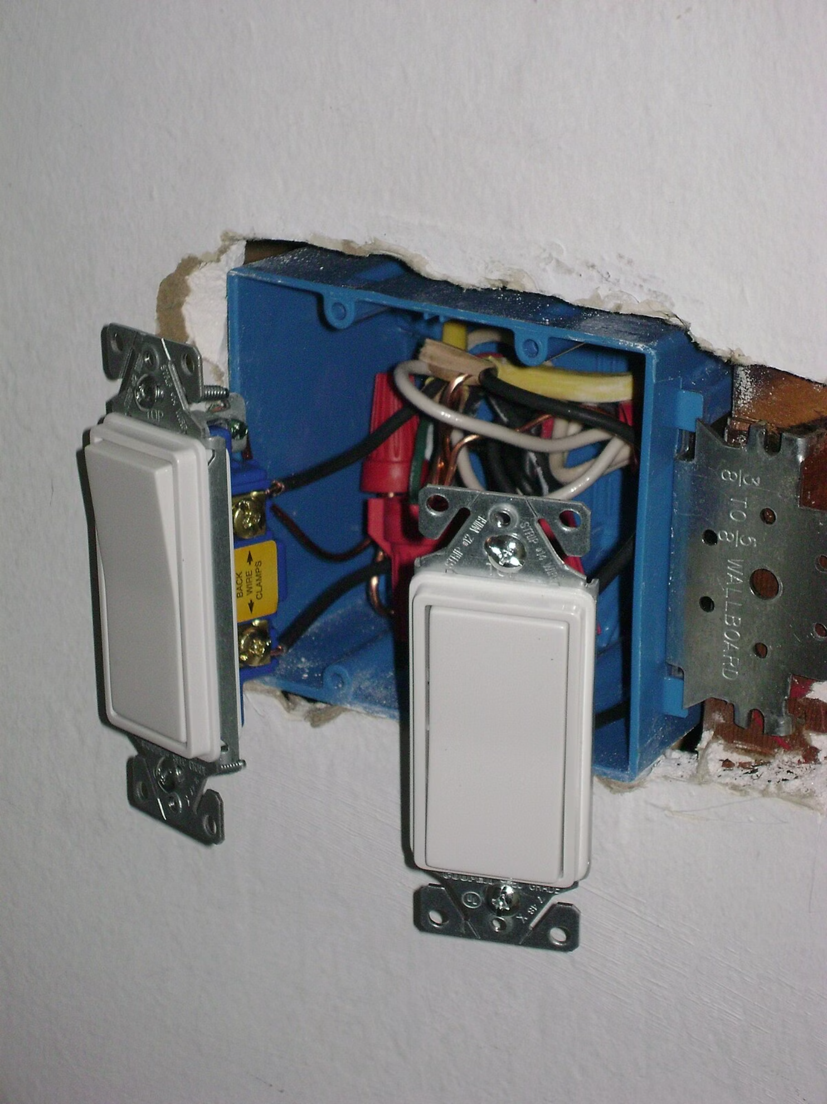
Existing Model: Manual Switch System
Current Approach
The traditional manual switch system requires users to physically turn ON and OFF appliances each time they enter or leave a room.
How It Works
Users must remember to operate switches manually, with no automated mechanism to prevent energy waste when rooms are unoccupied.

Slide 5
Limitations of Existing System
Human Negligence
Increased Electricity Costs
People often forget to turn off appliances when leaving rooms, resulting in prolonged unnecessary operation and wasted energy.
Continuous operation of lights and fans in empty rooms leads to significantly higher electricity bills for households and institutions.
Energy Wastage
Not Environmentally Friendly
Manual systems contribute to substantial energy wastage, which has environmental and economic consequences over time.
Excessive power consumption increases carbon footprint and contradicts sustainability goals and eco-friendly practices.

Slide 6




Proposed System: Automated Energy Saving
PIR Sensor Detection
Motion sensor continuously monitors room for human presence
Intelligent Processing
System processes sensor data and makes control decisions
Relay Control
Relay module switches appliances ON or OFF automatically
The system operates exclusively based on detected human presence, ensuring appliances function only when needed and conserving energy during empty periods.

Slide 7
Methodology
Power Supply Setup
Connect 5V power supply to both PIR sensor and relay module for proper operation.
PIR Motion Detection
PIR sensor continuously monitors the room, detecting infrared radiation emitted by human bodies.
Signal Transmission
When motion is detected, PIR sensor sends electrical signal to relay module indicating presence.
Appliance Switching
Relay module receives signal and switches connected appliances ON or OFF accordingly.
Automatic Shutdown
If no motion is detected for preset delay period, relay automatically turns appliance OFF to save energy.

Slide 8
Components Required
PIR Motion Sensor
Relay Module
5V Power Supply
Passive infrared sensor for detecting human body heat and movement
Switching device that controls high-power appliances using low-power signals
Adapter providing stable power for sensor and relay operation
LED/Bulb or Fan
Breadboard
Connecting Wires
Appliance to be controlled automatically based on occupancy
Prototyping board for connecting components without soldering
Jumper wires for establishing electrical connections between components
Switch (Optional)
Manual override switch for emergency control or testing purposes

Slide 9
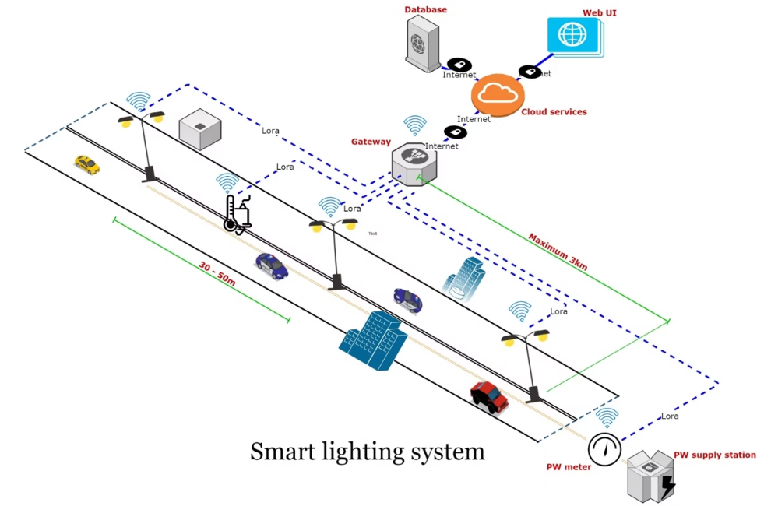
Result and Discussion
Successful Motion Detection
The PIR sensor reliably detected human presence with high accuracy, responding quickly to movement within its detection range.
Automatic Operation
Light or fan automatically turned ON immediately when person entered the room, providing instant response to occupancy.
Energy-Efficient Shutdown
Appliance turned OFF automatically after preset delay when room became empty, eliminating unnecessary power consumption.
Effective Power Conservation
System successfully reduced power wastage by ensuring appliances operated only during actual occupancy periods.

Slide 10

Conclusion
Electricity Conservation
Cost-Effective Solution
The Smart Energy-Saving Room System effectively conserves electricity by eliminating unnecessary appliance operation in empty rooms.
System is low-cost, simple to implement, and provides quick return on investment through reduced electricity bills.
Versatile Application
Suitable for classrooms, homes, offices, restrooms, and other spaces where occupancy varies throughout the day.
Future Enhancements: Integration with IoT for remote monitoring, smartphone app control, and data analytics for energy consumption patterns.

